Slide 1
INVESTMENT CASE STUDY SUBMISSION
Group Name: Quantitative-Soothsayers
Chayan Chatterjee
Devanshi Kulshreshtha
Hemanth Ponnada
Himanshu Srivastava

Slide 2
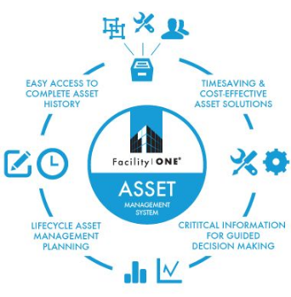

ABSTRACT
Spark Funds is an asset management company, managing their clients’ money by investing their pooled funds into securities that match declared financial objective. The company’s goal is to provide investors with more diversification and investing options than they would have by themselves.
The company has recently received funds from various investors/clients and they are looking for good companies where these funds can be invested.
The objective is to understand the global trends in investments- the sectors, countries or investment type attracting the most investment. For the ease of communication, only English-Speaking countries where they can spend between 5-15 million USDs per round of investment are being explored.

Slide 3
Problem solving methodology
Business & Data Understanding
Data
Preprocessing
Data Analysis
Visual Plots & Insights
Conclusion & Recommendations
Specifying the objective- Identifying the best sectors, countries & suitable investment type for making investments
Data
Information about companies
Details of funding rounds (Source: Crunchbase)
Understanding the datasets – Details of 66368 companies and their funding rounds was available
Cleaning the data- NAs in invested amount were excluded for key metric calculations, considered only 8 main sectors
R was used for data preprocessing
Investment Type Analysis : Investment trend in ventures, seed/angel, private equity categories
Country Analysis : English-speaking countries which had maximum investments in past
Sector Analysis : Distribution of investment across eight main sectors
Plot 1 : Investment vs. Fund Type Analysis
Plot 2 : Top 9 Countries Investment Analysis
Plot 3 : Analysis of Investments in Top 3 Sectors of Top 3 Countries
Tableau was used for creating plots
Strategy for making fund investments in countries across the globe (English -Speaking countries)
Recommendations for making investments in best sectors to get the maximum returns

Slide 4
SNAPSHOT
OBJECTIVE
Identify global trends in investments i.e. best sectors, countries and investment type
DATA
Crunchbase.com
STRATEGY
Investing where most investments are occurring
CONSTRAINTS
Investment in only English speaking countries
Only 5-15 million is available per round of funding

Slide 5
Analysis - I
INVESTMENT TYPE ANALYSIS
Venture Funding is the most suitable for Spark Funds
Average investment in venture funds falls in the 5-15 million USD band available for investment
Commonly invested in startups
Occurs after seed/angel stage of startup funding
COUNTRY ANALYSIS
The top three English-Speaking Countries attracting the highest total investments in the venture funding category
United States of America (USA)
United Kingdom (UK)
India (IND)
United States leads by a big margin, while UK and India stand at lower than half the amount

Slide 6
Analysis - II
SECTOR ANALYSIS
Sector of the company identified as the first category listed for it. 8 main sectors were identified:
Top sectors in the top 3 countries identified:
Automotive & Sports | Manufacturing
Cleantech / Semiconductors | News, Search and Messaging
Entertainment | Others
Health | Social, Finance, Analytics, Advertising
 | United States of America | United Kingdom | India
Top Sector | Others | Others | Others
Second Sector | Social, Finance, Analytics, Advertising | Social, Finance, Analytics, Advertising | Social, Finance, Analytics, Advertising
Third Sector | Cleantech / Semiconductors | Cleantech / Semiconductors | News, Search and Messaging

Slide 7
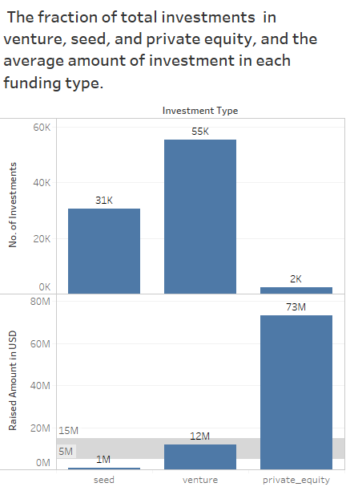
Investment Type
Insights :
Venture Funds attract the maximum number of investments (~55k, seen in upper panel)
Venture Funds are the most suitable investment type for Spark Funds (lies 5-15 M, lower panel)
Seed investment fall below the 5-15 million USD band available to invest per round
Private Equity greatly overshoots the 5-15 million USD investment band available with Spark Funds

Slide 8
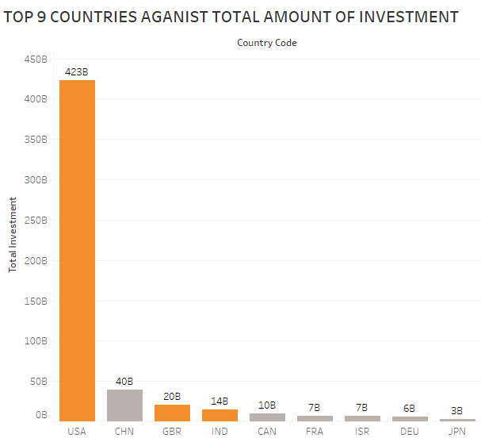
Top 9 Countries for Investment
Insights :
United States of America is the leading English Speaking country attracting most of the investments
Total investment flowing into United States is more than double the investment made in the top 2nd country
United Kingdom is the 2nd most attractive country for investment.
India is the 3rd most attractive country for venture funds.

Slide 9
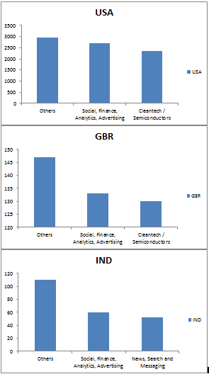
Identifying the best Sectors
Insights :
The Investment patterns in USA and UK are the same- “Others” is the leading sector, followed by “Social, Finance, Analytics, Advertising”, “Cleantech / Semiconductors” and “News, Search and Messaging”
India is also led by the ‘Others category’. ‘Social, Finance, Analytics, Advertising’ is the 2nd most attractive sector, while ‘News, Search and Messaging’ is the third.

Slide 10
Conclusion & Recommendations
Spark Funds should take the following points into consideration while investing :
INVESTMENT TYPE:
Venture Funding is the most popular investment type
COUNTRIES:
United States of America, Great Britain and India are the top English speaking countries attracting investment.
SECTORS:
If investing in USA or UK, consider investing in the top three sectors
Others
Social, Finance, Analytics, Advertising
Cleantech/Semiconductors
If Investing in India, consider investing in these sectors:
Others
Social, Finance, Analytics, Advertising
News, Search and Messaging

